Slide 1
LESSON 26.01 · WEEK 26
What Are the Properties
of Matter?
CPALMS SC.3.P.8.1 · Properties of Matter

Slide 2
OUR BIG QUESTION
Think About This...
"How do scientists describe and compare different kinds of matter?"
By the end of this lesson, you will know how to observe and measure the properties of matter.

Slide 3
OBJECTIVES
I Can Statements
I can describe matter by its properties like color, shape, texture, and hardness.
I can use tools to measure properties like mass, volume, and temperature.
I can compare two objects by their properties and explain how they are different.
Notes:
Readiness map: I Can #1 (describe matter by properties) rehearsed in Section 2 (Slide 10) and the Notice & Wonder object observation (Slide 5). I Can #2 (use tools to measure mass/volume/temperature) rehearsed in Section 3 (Slide 11) and Investigation Step 2 (Slide 16). I Can #3 (compare two objects by properties) rehearsed in Investigation Steps 3-4 (Slide 17) and the formal Write & Explain (Slide 25). All three assessed in Self-Check (Slides 20-22) and Assignment (Slides 23-25).

Slide 4
YOU'LL NEED
Materials
Science notebook
Pencil & colored pencils

Slide 5
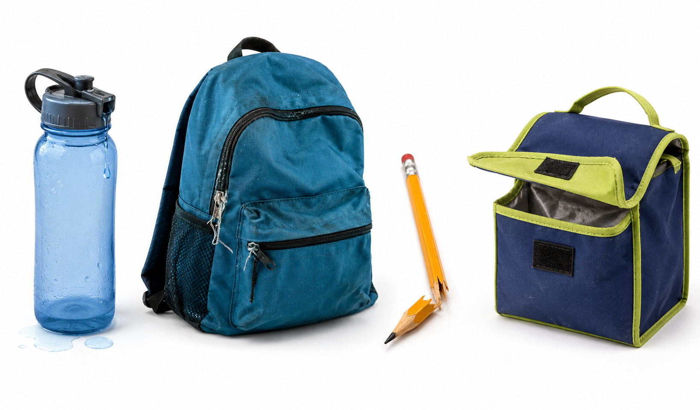
NOTICE & WONDER
What Can You Observe?
Every object has properties you can observe and describe.
WHAT DO YOU NOTICE? WHAT DO YOU WONDER?
Pick any three objects near you. For each one, write down its color, shape, and how it feels. Then write one question: how are these objects different from each other?

Slide 6
WORD WALL
Key Vocabulary — Part 1
Matter
Anything that takes up space and has weight. Solids, liquids, and gases are all matter.
Property
A feature of an object you can observe or measure — like color, shape, or size.
Mass
How much matter is in an object. You measure mass using a balance or scale.

Slide 7
WORD WALL
Key Vocabulary — Part 2
Volume
How much space an object takes up. A basketball has more volume than a tennis ball.
Texture
How the surface of an object feels — smooth, rough, bumpy, or soft.
Hardness
How easily an object can be scratched. A diamond is very hard. Chalk is soft.

Slide 8
COPY THIS DOWN
In Your Science Notebook
"Scientists describe matter by observing and measuring its properties, like mass, volume, and texture."

Slide 9
THE LESSON · SECTION 1
What Is Matter?
Everything around you is made of matter. Your desk, the air you breathe, even the water you drink — it is all matter. Matter is anything that takes up space and has weight. Scientists study matter by looking closely at its properties.
SCIENTIST TALK
Can you think of something that is NOT matter? What about light or sound — do they take up space?

Slide 10
THE LESSON · SECTION 2
Observable Properties
Every object has properties you can see, feel, or measure. Some are easy to spot — color, shape, and size. Others take more careful looking. Texture tells you how the surface feels — smooth, rough, bumpy. Hardness tells you if it scratches easily or not. A rock is hard. Clay is soft.

Slide 11
THE LESSON · SECTION 3
Measuring Properties
Some properties need tools to measure. Scientists use a balance to find mass — how much matter is in an object. They use rulers and containers to find volume — how much space an object takes up.
Real-World Connection
When you pick up a bowling ball and then pick up a basketball, the bowling ball feels much heavier — it has more mass.

Slide 12
KEY CONCEPT
Matter and Its Properties
KEY CONCEPT
Every object is made of matter and has properties that scientists can observe and measure, like mass, volume, color, texture, and hardness.

Slide 13
AMAZING NATURE FACT
A Teaspoon of a Neutron Star
A teaspoon of a neutron star would weigh about 6 billion tons — that is more mass than every car on Earth combined, squeezed into one tiny spoon!

Slide 14
CURIOUS? GO DEEPER
Sorting by Properties
Scientists sort objects into groups based on their properties. You could sort rocks by color, or by hardness, or by texture. Each way of sorting tells you something different. When you sort objects into groups, you are classifying them. Classification helps scientists organize the world and find patterns.
SCIENTIST TALK
Next time you see a pile of objects, try sorting them two different ways. What do you notice?

Slide 15
INVESTIGATION
Properties Sort
Observe, describe, and compare objects by their properties. You'll need 3-5 small objects from around your home (a coin, eraser, spoon, rock, sponge, etc.).

Slide 16
REHEARSAL · STEPS 1–2
Gather, Observe & Record
Step 1 — Gather and Observe: Find 3-5 small objects. Look at each one carefully. What color is it? What shape? How does the surface feel?
Step 2 — Record Properties: Copy the properties chart into your notebook. Fill in each column for every object.

Slide 17
REHEARSAL · STEPS 3–4
Compare & Classify
Step 3 — Compare: Hold two objects in your hands. Which one feels heavier? Which is smoother? Write your comparisons in your notebook.
Step 4 — Classify: Sort your objects into two groups based on one property (rough vs. smooth). Then re-sort them a different way (heavy vs. light).
SCIENTIST TALK
Which property was easiest to observe? Which one was hardest? Why?

Slide 18
REHEARSAL · RECORD YOUR THINKING
Organize What You Observed
What properties did you observe for each object? List at least three.
Which two objects were the most different from each other? How?
Draw and label your two sorting groups. Show which objects went in each group.
Tell the story of your investigation from beginning to end — what you did, what you noticed, and what you figured out.

Slide 19
DISCUSSION · THINK IT THROUGH
Think Through Each Question On Your Own
What did you notice about the texture of your objects? Were any surprising?
What evidence from your chart supports that two objects have different properties?
Where do people sort objects by properties in real life? (Think about grocery stores, recycling, or toolboxes.)
If you could add one more column to your chart, what property would you measure?

Slide 20
QUICK SELF-CHECK · QUESTION 1
What Is a Property?
What is a property of matter?
A) A feature you can observe or measure, like color, texture, or mass
B) The place where an object is found
C) How fast an object moves
WHAT DO YOU NOTICE? WHAT DO YOU WONDER?
What do you notice in this scenario that helps you decide? What do you wonder about before you answer?
CHAT
Think about what you can see, feel, or measure about an object — that is a property.
Notes:
Tests the core definition of property.

Slide 21
QUICK SELF-CHECK · QUESTION 1
What Is a Property? — Answer
Correct: A — A property is something you can observe or measure about an object.
Notes:
Reinforce that property refers to observable/measurable features, not location or speed.

Slide 22
QUICK SELF-CHECK · QUESTION 2
Rock vs. Sponge
Two students pick up a rock and a sponge. The rock feels much heavier. What property is different?
A) Color
B) Mass
C) Shape
WHAT DO YOU NOTICE? WHAT DO YOU WONDER?
What do you notice in this scenario that helps you decide? What do you wonder about before you answer?
CHAT
When something feels heavier, it has more of which property? Hint: it starts with M.
Notes:
Tests applying the concept of mass to a real comparison.

Slide 23
QUICK SELF-CHECK · QUESTION 2
Rock vs. Sponge — Answer
Correct: B — The rock has more mass than the sponge; that is why it feels heavier.
Notes:
Reinforce that feeling heavier means having more mass.

Slide 24
QUICK SELF-CHECK · QUESTION 3
Which Tool Measures Mass?
Which tool would a scientist use to measure the mass of an object?
A) A ruler
B) A thermometer
C) A balance or scale
WHAT DO YOU NOTICE? WHAT DO YOU WONDER?
What do you notice in this scenario that helps you decide? What do you wonder about before you answer?
CHAT
A ruler measures length and a thermometer measures temperature. Which tool measures how heavy something is?
Notes:
Tests matching the correct measurement tool to the property of mass.

Slide 25
QUICK SELF-CHECK · QUESTION 3
Which Tool Measures Mass? — Answer
Correct: C — A balance or scale measures mass, how much matter is in an object.
Notes:
Reinforce the tool-property pairings: ruler=length, thermometer=temperature, balance=mass.

Slide 26
ASSIGNMENT · PART A
Properties Chart
Complete the following, describing two properties for each object:
A metal coin: _______ and _______
A cotton ball: _______ and _______
A brick: _______ and _______

Slide 27
ASSIGNMENT · PART B & WRITE AND EXPLAIN
Short Answer + Compare Objects
Part B (complete sentences): 1) What is the difference between mass and volume? 2) If two boxes look the same size but one is much heavier, what property is different? Why? 3) Give one example of a property you can see and one you need a tool to measure.
WRITE & EXPLAIN — How can you use properties to tell two objects apart — even if they look similar?
Start with: "I think the most useful property for comparing objects is…"
Then: "I know this because when I observed my objects, I noticed…"
Finish with: "This makes sense because scientists need to measure properties to…"

Slide 28
ASSIGNMENT · PART C & SUBMISSION
Draw & Label + What to Turn In
Part C: Draw two objects side by side. Label at least 3 properties for each one (use arrows pointing to each property). Make sure at least one property is different between the two objects.
SUBMIT ON CANVAS — must include:
Completed properties chart from the Explore activity
Sorting groups drawing with labels from the Explore tab
Short answer responses to Part B (complete sentences)
Write & Explain response using at least one vocabulary word
Part C drawing with 3 labeled properties for each object

Slide 29
Great Work Today!
Everything around you is made of matter — and every piece of matter has properties you can observe and measure!
Lesson 26.02 · Measuring Matter

